Slide 1
Exercise #2

Slide 2
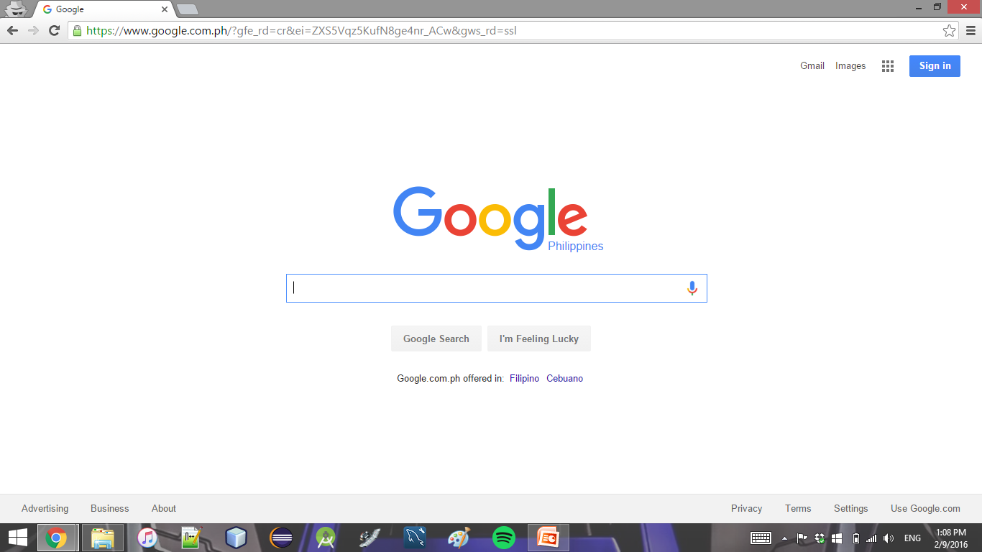

Slide 3
Recreate the Google Homepage
Use HTML and CSS
None of the buttons need to be functional
Using frameworks is discouraged (for now)
Bonus feature: make it so that when the user enters something on the text bar, and then presses enter / the search button, the page goes to the actually google search result for the input

